Slide 1
Product and Marketing Analysis Report
Presented by: Ayat Ezzaldien Elsiddeg Ahmed

Slide 2
Agenda:
Overview of topics covered in the presentation:
Introduction
Executive Summary
Best-Selling Products Analysis
Trending Products Analysis
Customer Segmentation
Segment-Specific Trends
Recommendations
Conclusion and Next Steps

Slide 3
INTRODUCTION
This project aims to analyze Marketing data to extract valuable insights that can inform business decision-making. It involves identifying sales trends, top-selling products, and key revenue metrics.
In "Sales Data Analysis," I worked with a substantial sales dataset to explore various aspects of the business. l analyze sales trends over time, determine which products are top sellers, calculate essential revenue metrics like total sales and profit margins, and create visualizations to effectively communicate my findings. This project demonstrates my ability to manipulate and extract insights from large datasets, enabling to make data-driven recommendations to optimize sales strategies.

Slide 4
Executive Summary
Key Insights:
1. Total Revenue & Sales Quantity: Revealing the overall financial impact of sales, including both revenue generated and the quantity of products sold. 2. Profit Analysis: Understanding the profitability of each transaction, crucial for evaluating the effectiveness of sales strategies. 3. Monthly Sales Trends: Identifying patterns and fluctuations in sales over time, enabling better forecasting and resource allocation. 4. Top Sales by Country : Locating geographical areas with high sales volumes, potentially indicating areas for further expansion or targeted marketing efforts. 5. Top Best-Selling Products: Recognizing the most popular products among customers, guiding inventory management and marketing strategies. 6. Top Products by Sales Count: Analyzing sales growth for different products, highlighting opportunities for product optimization and promotion.

Slide 5
Best-Selling Products Analysis

Slide 6
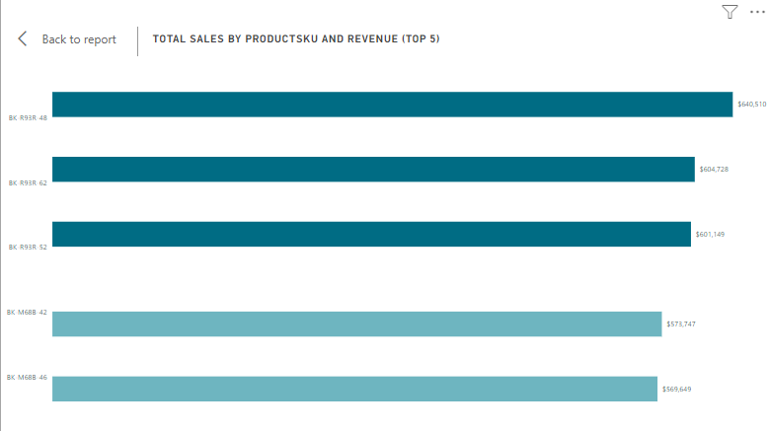
Top 10 Best-Selling Products
Product BK-R93R-48: Generated $640,000 in Sales, driven by High Value Customer Segment. High demand in Australia.
Product BK-R93R-62: Second best-selling product with $604,728 in sales. Most popular in United status), with a strong performance High Value Customer Segment.

Slide 7
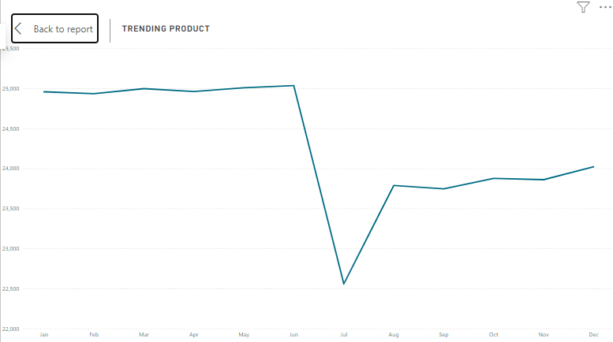
Trending Products Analysis
Sales trending has been increasing, peaking in June at 16.7% of total sales and $647,000 in revenue, declining significantly in July at $5.65% of sales and $279,000 in revenue, and starting to rise over the following months.

Slide 8
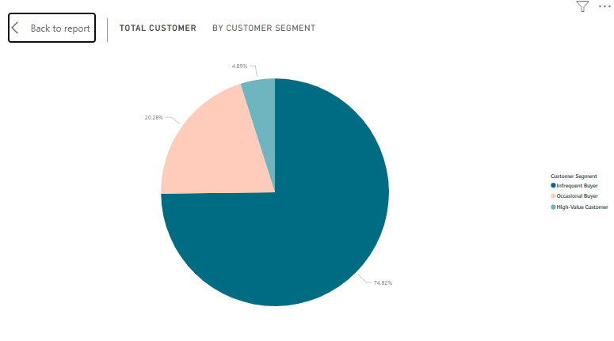
Customer Segmentation Analysis
Infrequent Buyer :
High Segment in Customer include 15762 (74,82%) From Total Customer
Occasional Buyer :
The second segment includes 4273(20.28%)
High-value Customer :
Include 1031 (4.89%)
Occasional Buyers contribute 67.7% of total sales.

Slide 9
Product and Marketing Recommendations
Product Features: Enhance product Category (Plant’s) features to better meet the needs of consumers in other countries. Consider incorporating technology-based elements into product Category (Plant Care& seeds)B to maintain its popularity among Infrequent Buyers.
Marketing Strategy: Launch a targeted campaign for product Category(Plants), focusing on Customer Segment (High Value & occasional). Highlight its unique features that appeal to this demographic.
Promote product Category (pots) with a dedicated campaign highlighting its price-performance and quality, bundle offers to increase sales among high-value customers.

Slide 10
Conclusion
This project has significantly enhanced my data manipulation skills and reinforced the importance of data-driven strategies in optimizing sales performance. I am grateful for the opportunity to contribute meaningfully to Meri Skill's mission and look forward to applying these insights in future projects.

Slide 11
Questions and Feedback
Please feel free to ask any questions or provide feedback.

Slide 12
THANK YOU
Ayat Ahmed
ayat@ezzaldieneco.com

